Slide 1


Any sufficiently advanced technology is indistinguishable from magic.

Slide 2

Characteristics and Quality attributes of Embedded System : Characteristics
Application and Domain specific
Reaction and Real time
Operation in harsh environment
Distributed
Small size and weight
Power concerns

Slide 3
Quality attributes of Embedded System
Operational quality attributes
Response time, Throughput, Reliability,
Maintainability, Security, Safety
Non-Operational quality attributes
Testability and Debug-ability, Evoluability,
Portability, Time to prototype and market,
Per unit and total cost

Slide 4
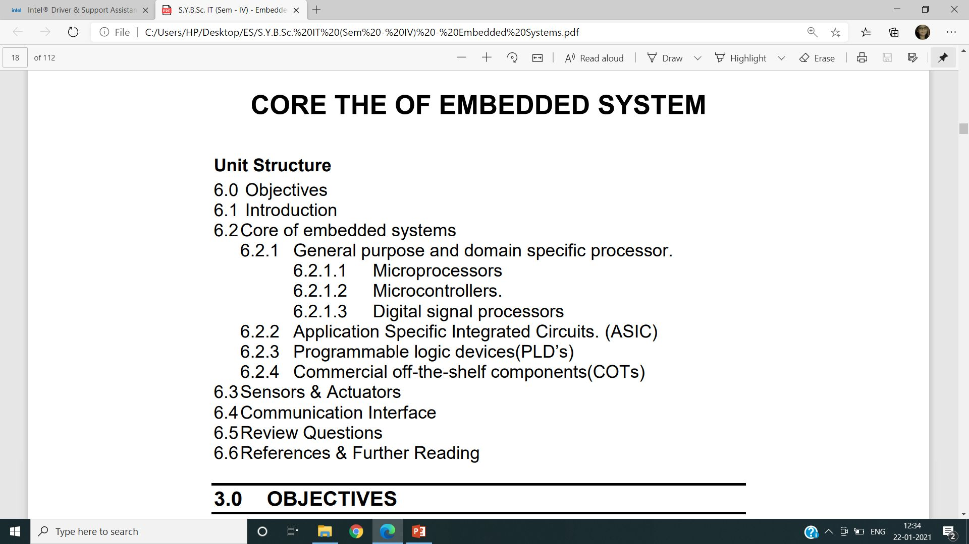
Chapter 2:Core of embedded system

Slide 5
Chapter 2:Core of embedded system
GENERAL PURPOSE AND DOMAIN SPECIFIC PROCESSOR.
MICROPROCESSORS
Architectures used for processor design are Harvard or Von-Neumann
RISC and CISC are the two common Instruction Set Architectures (ISA)
available for processor design.
Endianness specifies the order which the data is stored in the memory by
processor operations in a multi byte system.
1. Little Endian Processors 2. Big Endian Processors

Slide 6
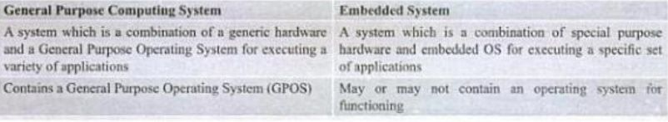
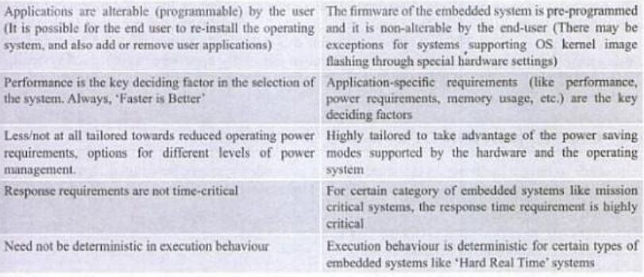
Chapter 2:Core of embedded system
GENERAL PURPOSE AND DOMAIN SPECIFIC PROCESSOR.

Slide 7
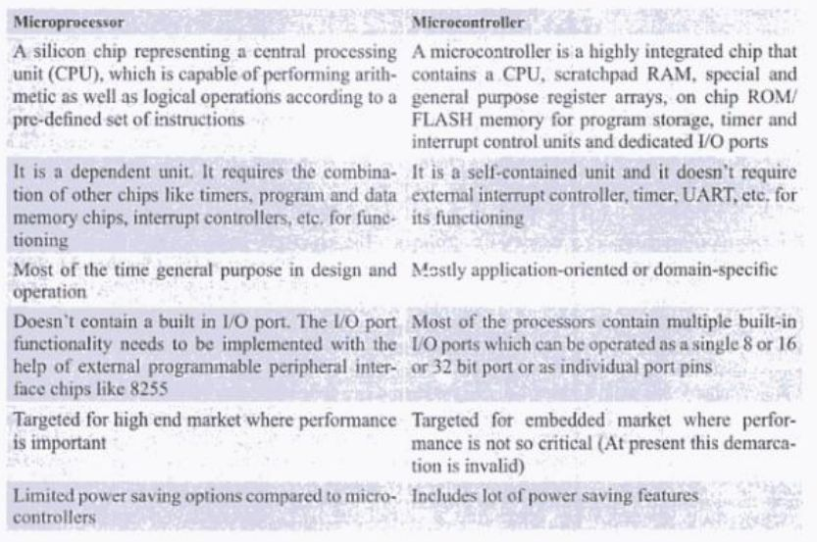
Chapter 2:Core of embedded system
Microprocessor and Microcontroller

Slide 8
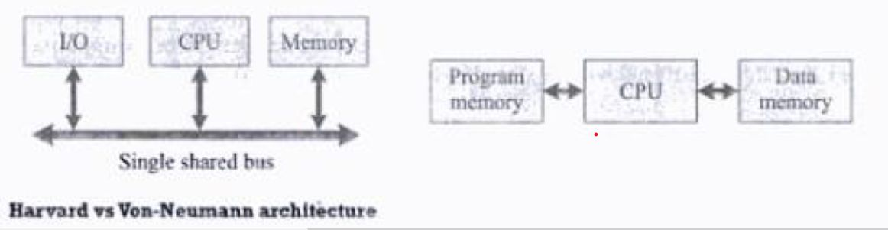
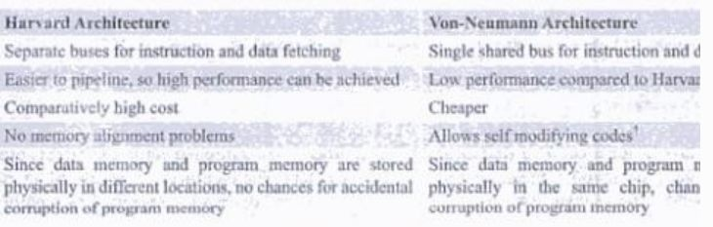
Chapter 2: Von-Neumann and Harvard Architecture

Slide 9
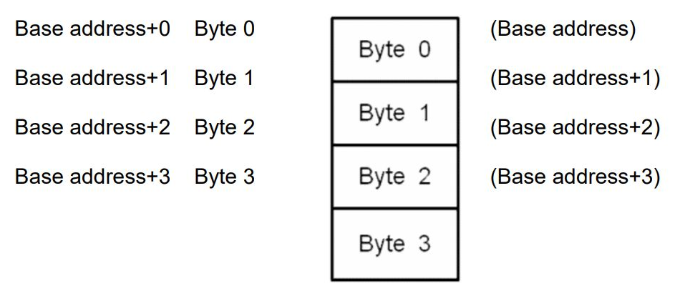
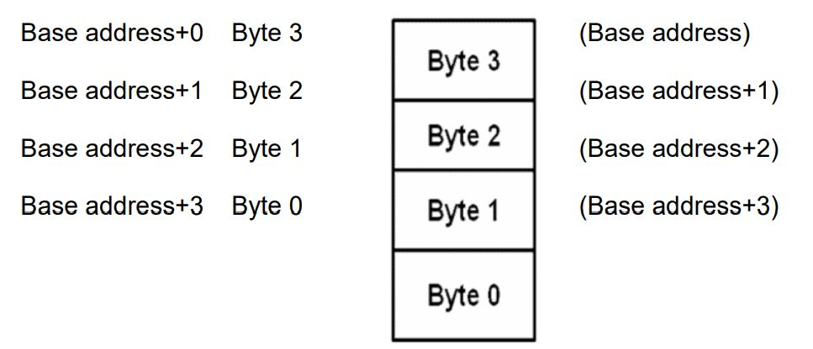
Chapter 2:Little Endian and Big Endian
Byte3 Byte2 Byte1 Byte0

Slide 10
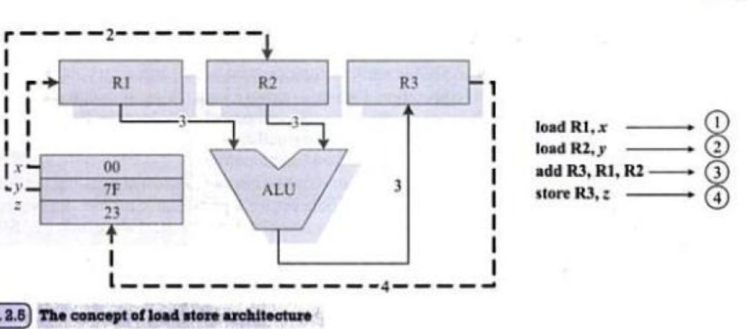
Chapter 2: store and load memory instructions

Slide 11
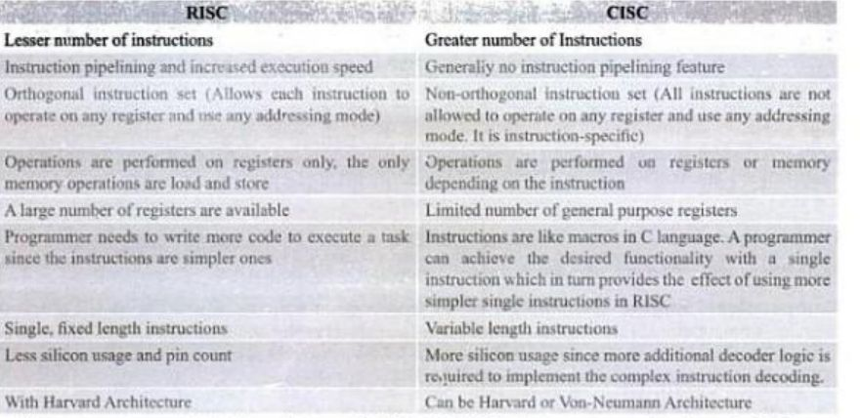
Chapter 2: store and load memory instructions

Slide 12
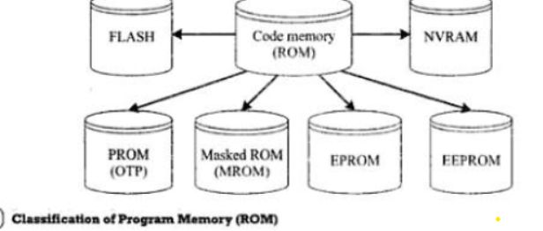
Chapter 2: Memory

Slide 13
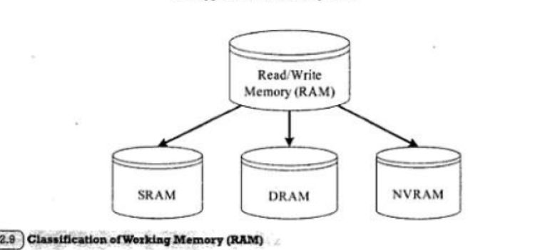
Chapter 2: Memory

Slide 14
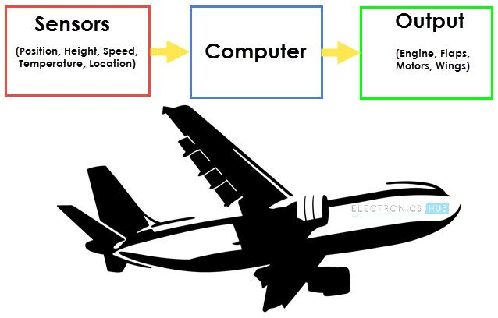
Sensors and Actuators

Slide 15
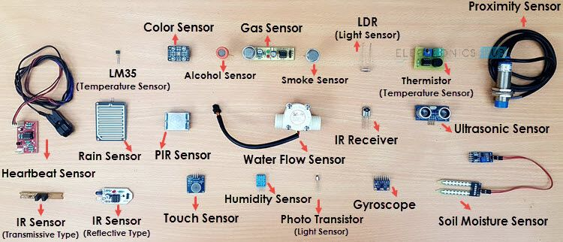
Sensors and Actuators

Slide 16
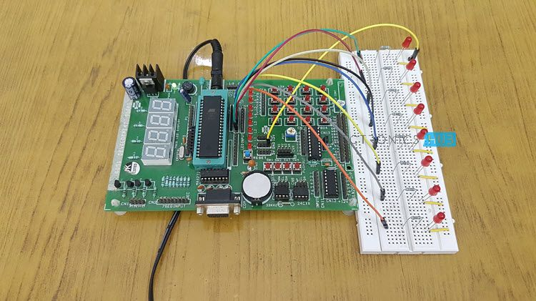
Sensors and Actuators

Slide 17
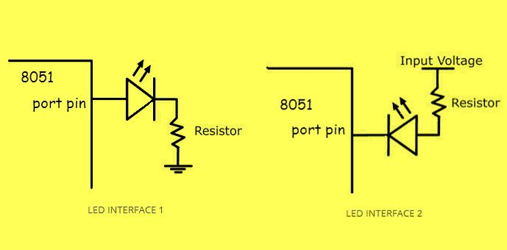
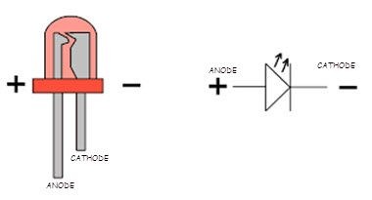
Sensors and Actuators

Slide 18
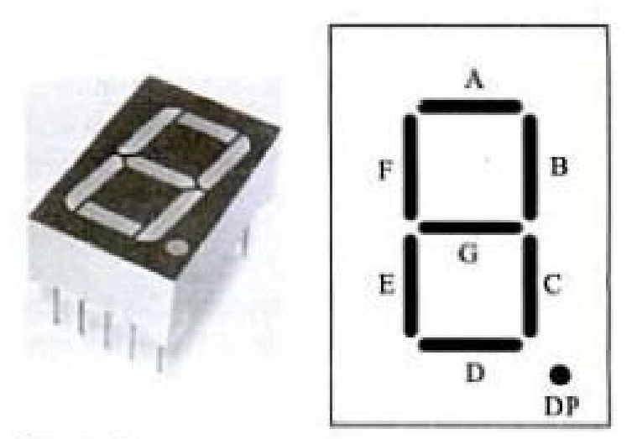
7-Segment LED Display Unit

Slide 19
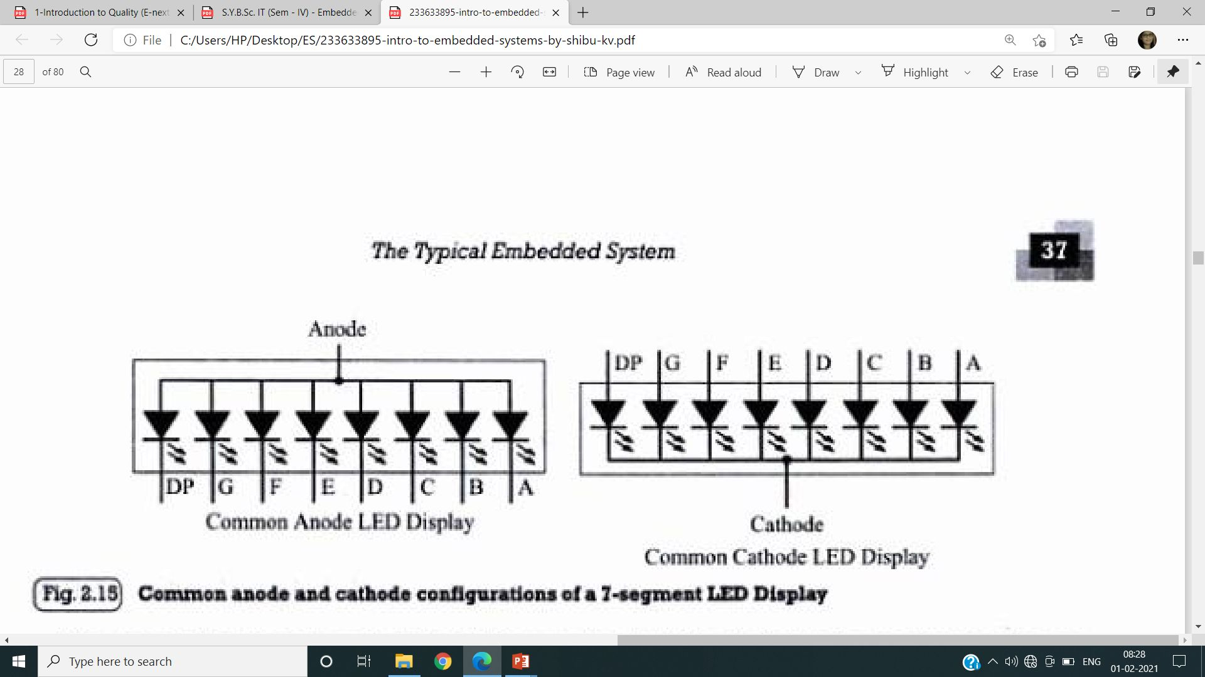
The 7-Segment LED Display Unit

Slide 20
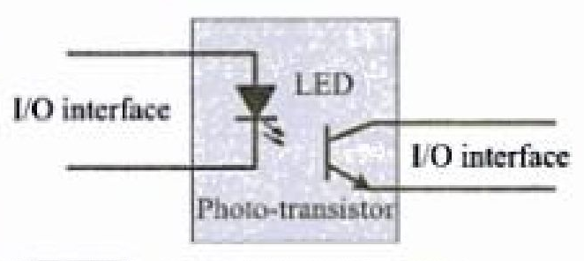
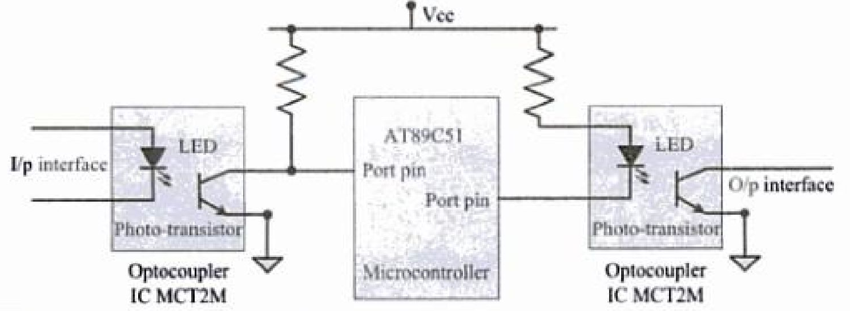
Optocoupler

Slide 21
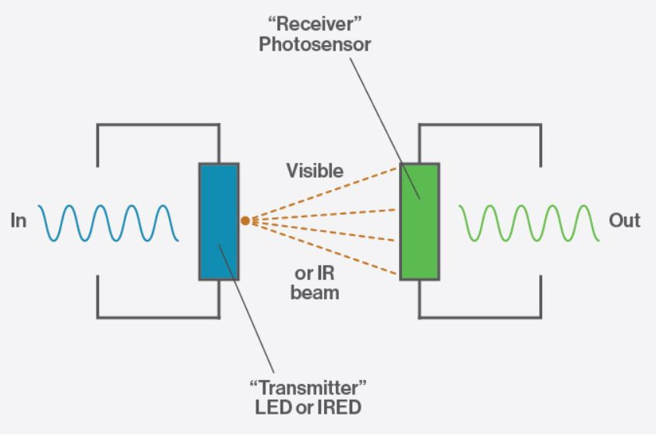
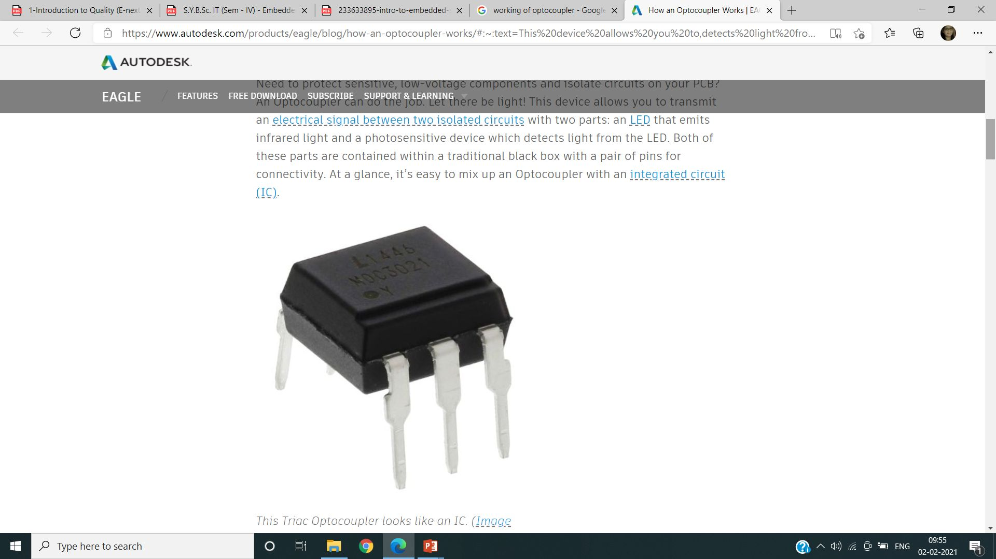
Optocoupler

Slide 22
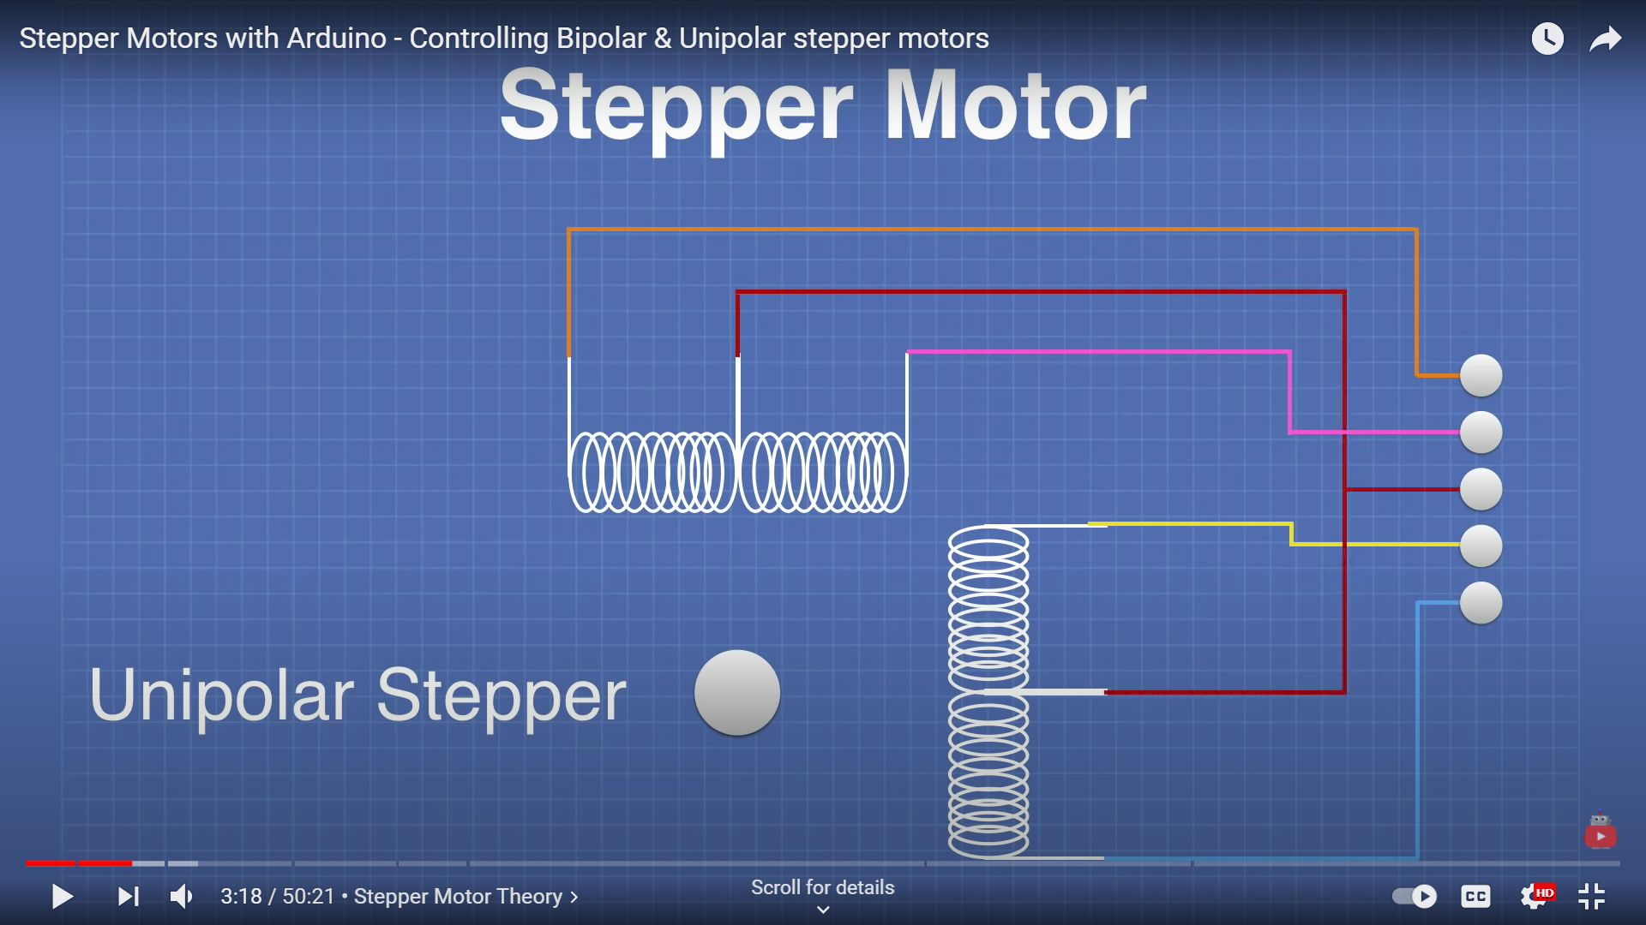
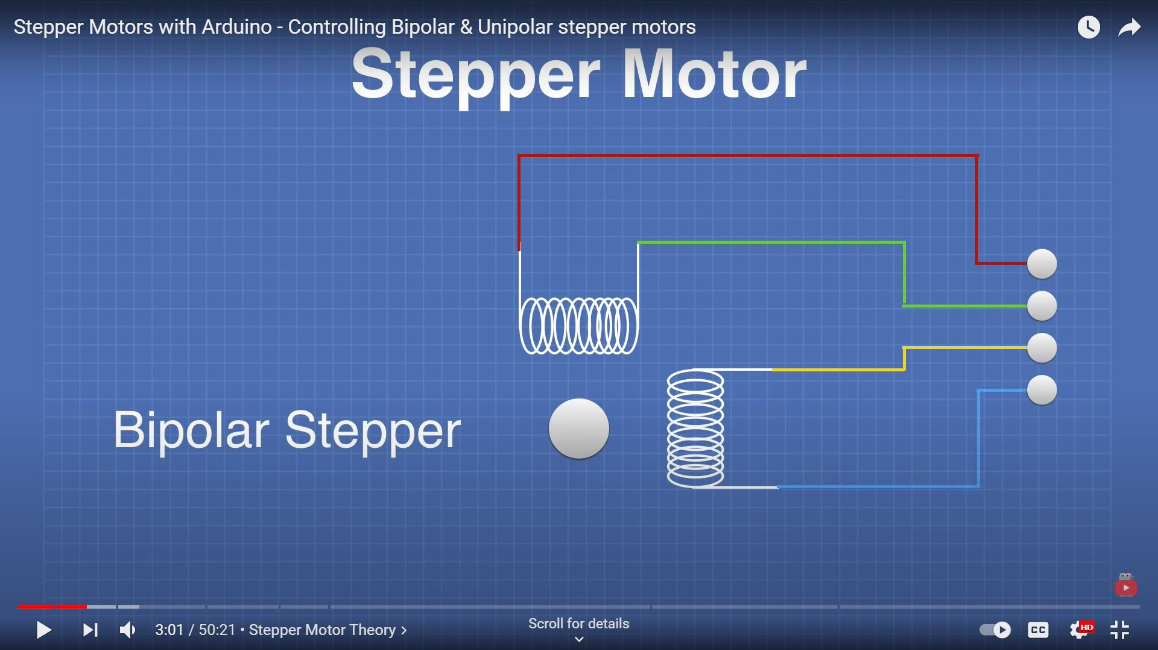
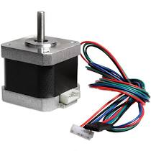
Stepper Motor

Slide 23
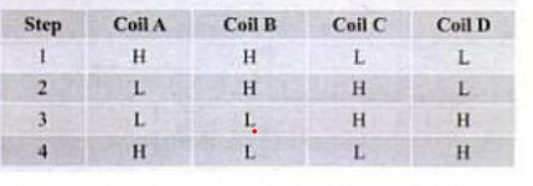
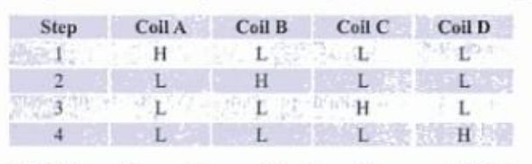
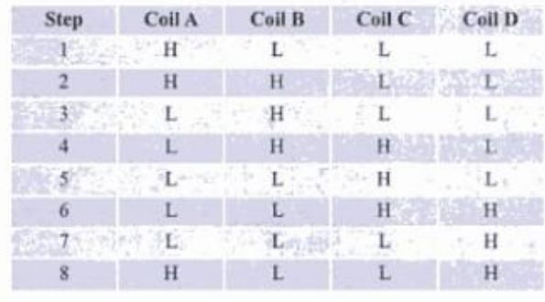
Stepper Motor(Full step, Wave step and Half step)
A
N
S
B
D
C

Slide 24
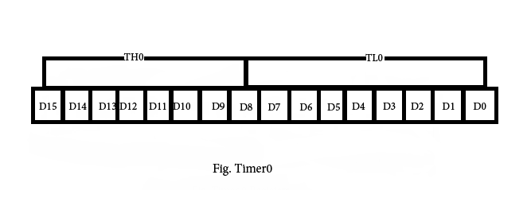
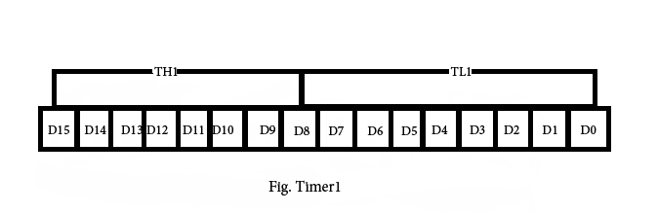
8051 Timers

Slide 25
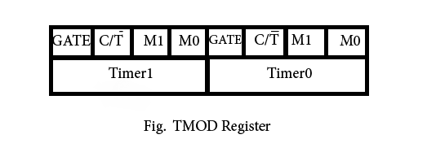
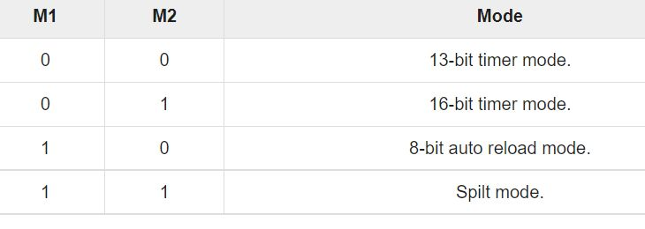
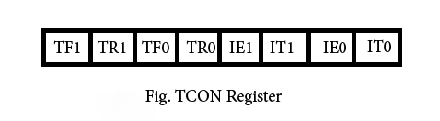
8051 Timers

Slide 26
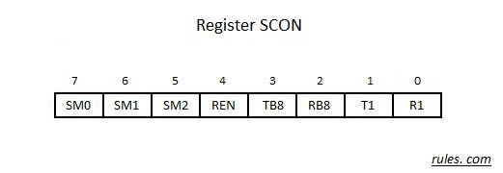
Serial Communication(scon register)

Slide 27
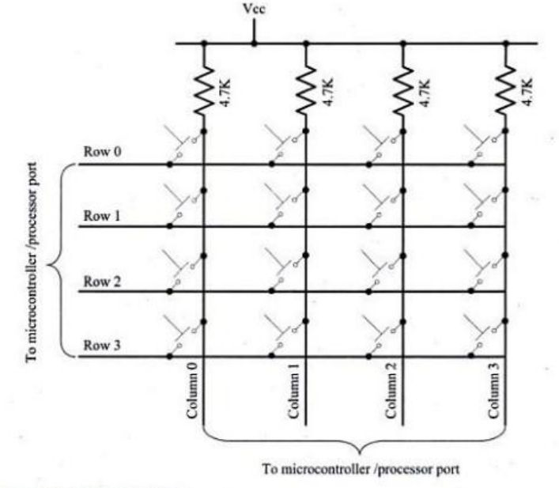
Matrix Keyboard

Slide 28
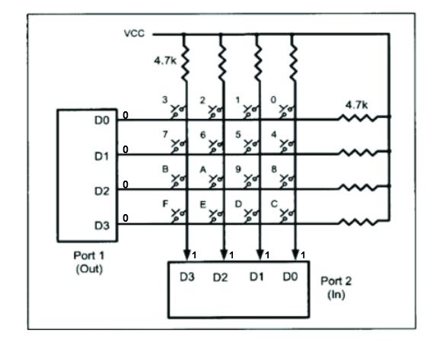
Matrix Keyboard

Slide 29
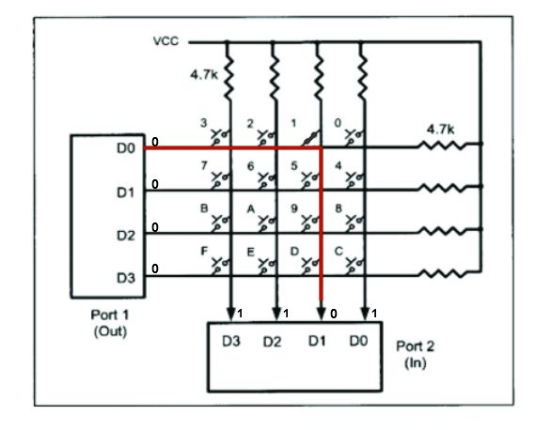
Matrix Keyboard
For Port 2 the values are currently D3D2D1D0 = 1101. The 0 indicates that a button in the D1 column is pressed.

Slide 30
PPI-Programmable Peripheral Interface
D7 | D6 | D5 | D4 | D3 | D2 | D1 | D0
1- C upper & C lower are I/O mode 0 – BSR mode | Port A 00-simple i/o mode 01-Handshake mode 1x-bi-directional port |  | Port A 0-O/P 1-I/P | Port C upper 0-O/P 1-I/P | Port B 0-8 bit i/o port. 1-handshake mode. | Port B 0-O/P 1-I/P | Port C lower 0-O/P 1-I/P

Slide 31
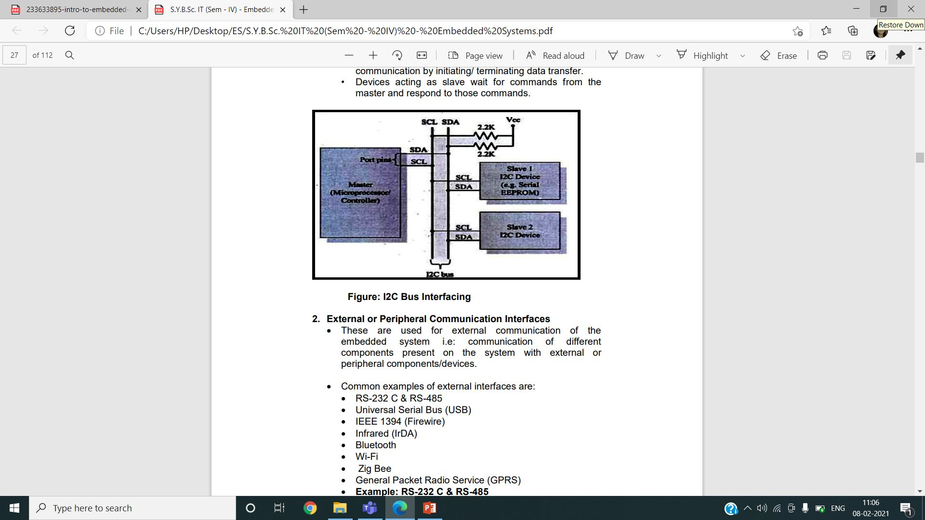
I2C

Slide 32
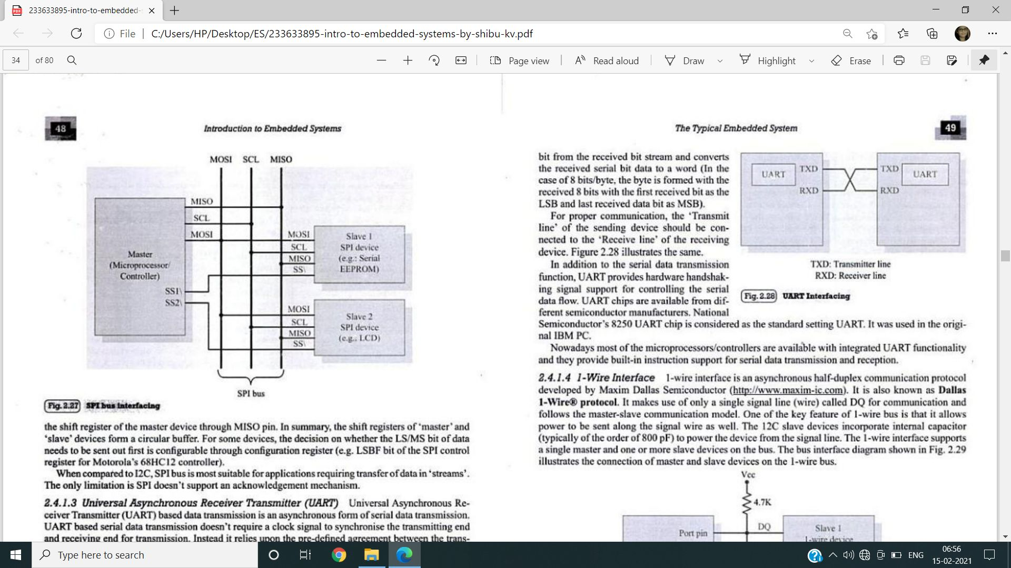
SPI

Slide 33
UART

Slide 34
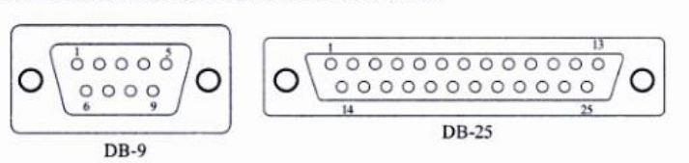
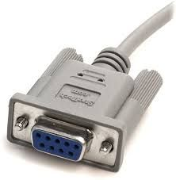
RS-232

Slide 35
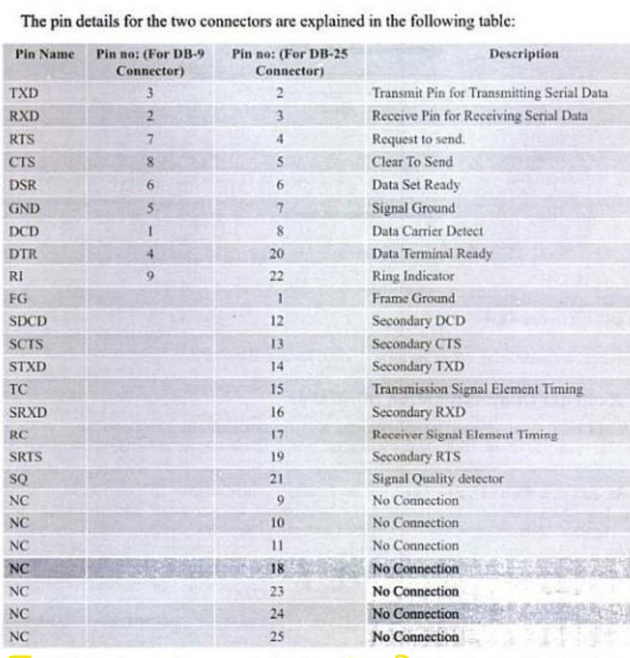
RS-232

Slide 36
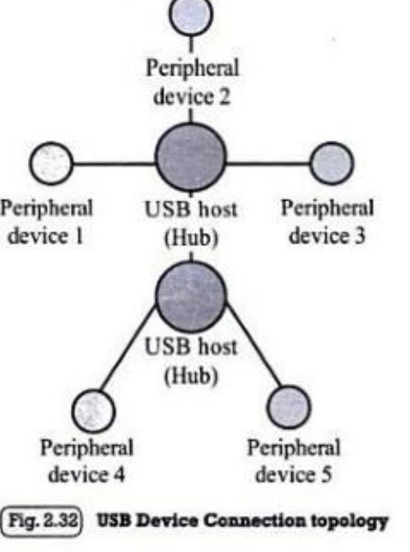
USB

Slide 37
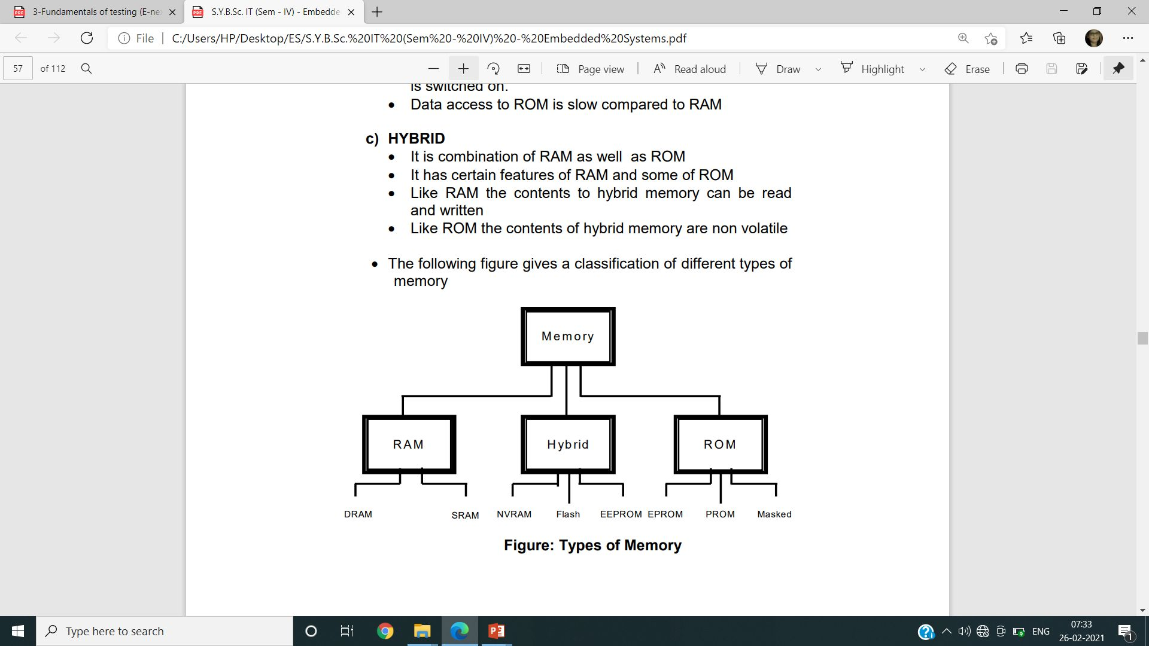
Memory

Slide 38
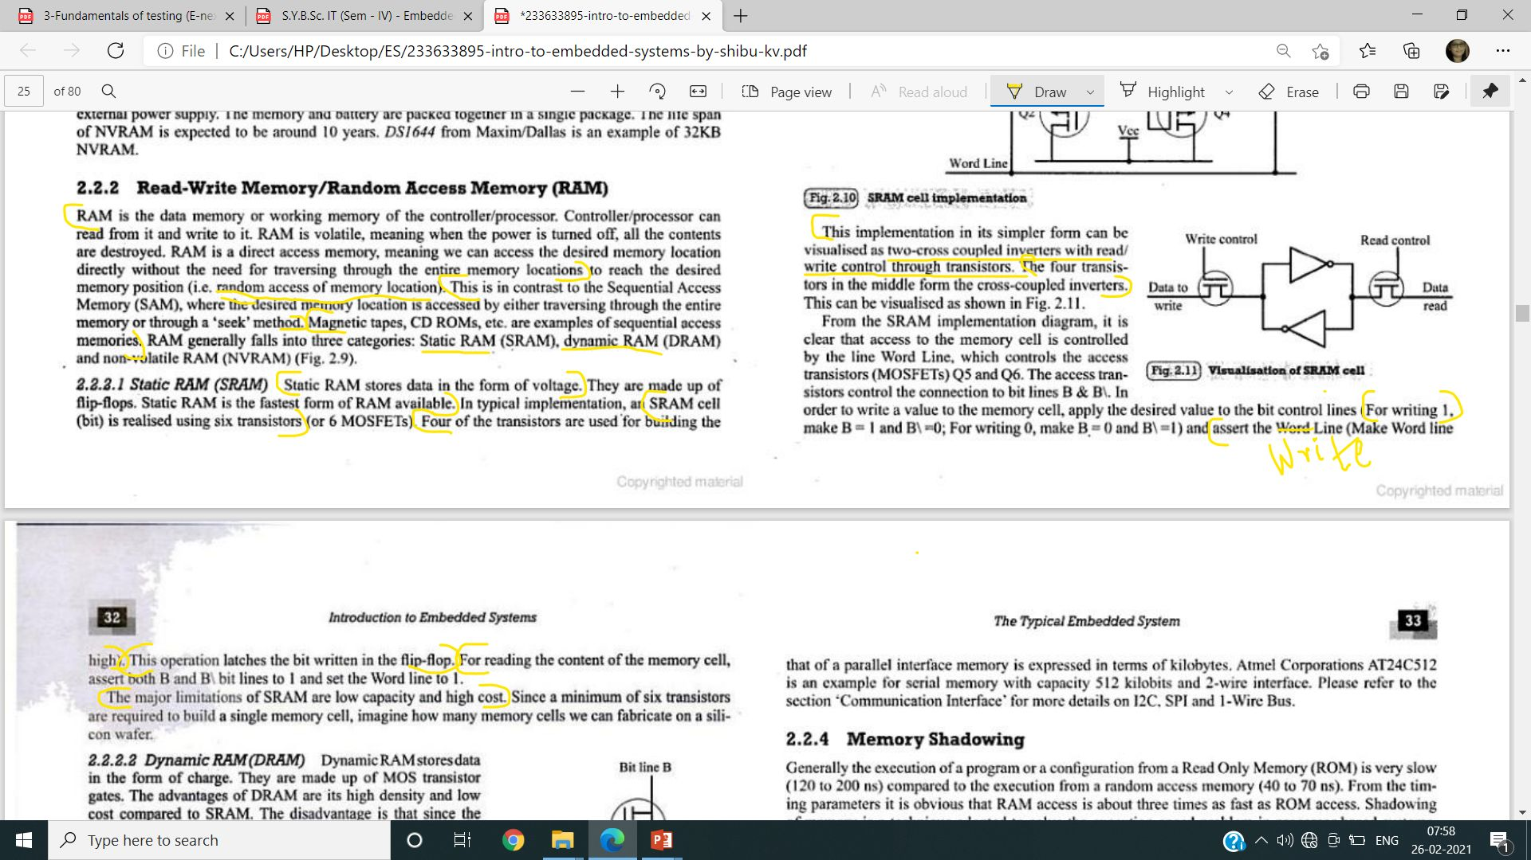
SRAM

Slide 39

EPROM

Slide 40
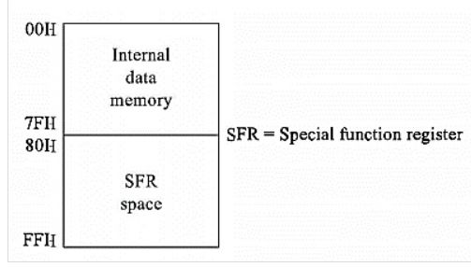
RAM

Slide 41
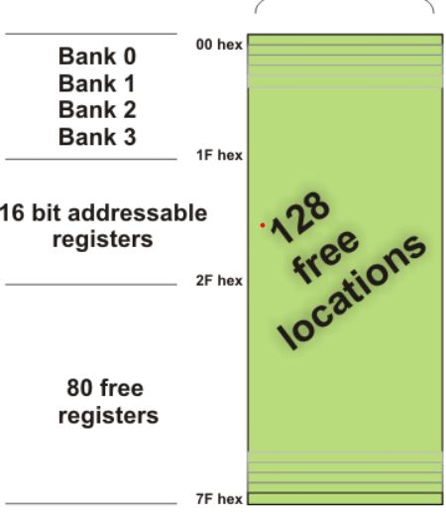
RAM

Slide 42
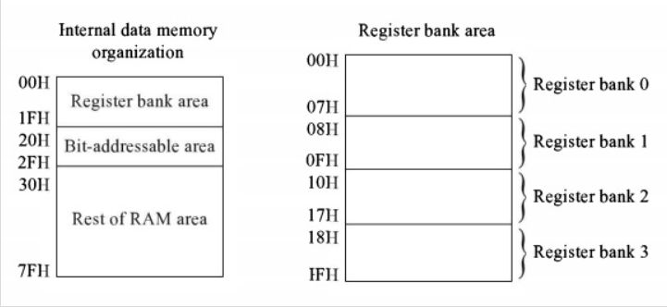
RAM

Slide 43
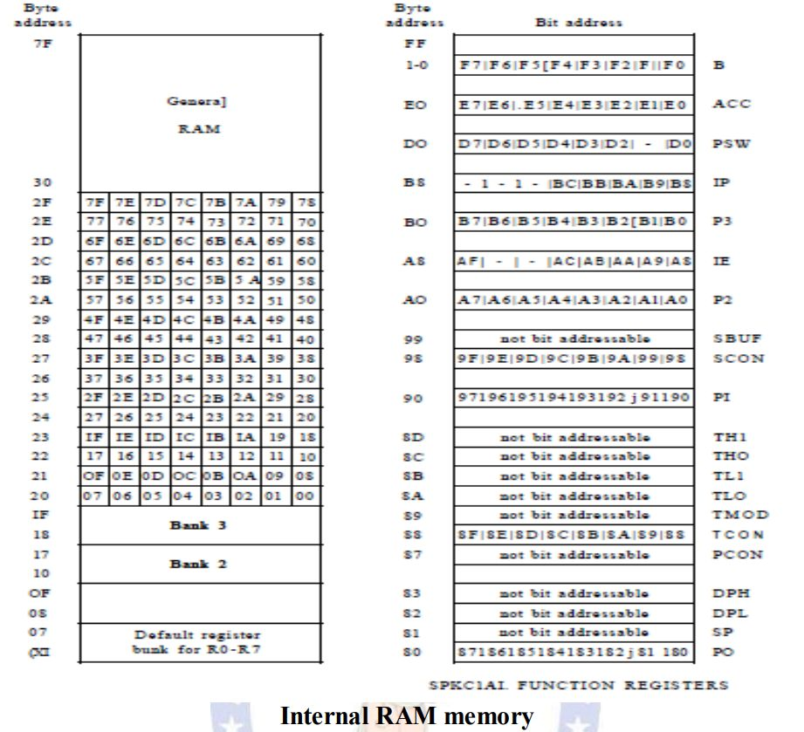
RAM

Slide 44


RAM

Slide 45


RAM

Slide 46

RAM
Notes:
BYTE Addressable Instruction:
MOV A, #03H
MOV, 20H, A
Bit Addressable Instruction:
SETB 01H
CLR 01H

Slide 47

ROM

Slide 48
ROM

Slide 49

Programming Embedded systems

Slide 50

Build Process in Embedded systems

Slide 51
Build Process in Embedded systems
The build process involves three steps:
Compiling
Linking
Locating

Slide 52

Build Process in Embedded systems: Compiling

Slide 53
Factors to be considered in selecting a controller
Feature set
Speed of operation
Code memory space
Data memory space
Development support
Availability
Power consumption
Cost

Slide 54

Watchdog Timer

Slide 55

Processor and I/O Communication: Programmed I/O
Notes:
https://quickcse.wordpress.com/2018/09/10/programmed-io-interrupt-driven-io-dma/
https://www.louiewong.com/archives/137

Slide 56

Processor and I/O Communication: Interrupt-Driven I/O
Notes:
https://quickcse.wordpress.com/2018/09/10/programmed-io-interrupt-driven-io-dma/
https://www.louiewong.com/archives/137

Slide 57

Processor and I/O Communication: DMA
Notes:
https://softwareengineering.stackexchange.com/questions/272470/how-does-a-dma-controller-work

Slide 58
Interrupts in 8051
TF0 – Timer Zero Overflow (2)
TF1 – Timer One Overflow(4)
INT0 – External Hardware Interrupt Zero (1)
INT1 - External Hardware Interrupt One (3)
TI/RI – Serial Communication Transmit Interrupt and
Serial Communication Receive Interrupt (5)
Notes:
https://softwareengineering.stackexchange.com/questions/272470/how-does-a-dma-controller-work

Slide 59

Interrupts registers in 8051
Notes:
https://softwareengineering.stackexchange.com/questions/272470/how-does-a-dma-controller-work

Slide 60

Interrupts registers in 8051
Notes:
https://softwareengineering.stackexchange.com/questions/272470/how-does-a-dma-controller-work

Slide 61

Embedded Operating System
Basics
Tasks
Task States
Notes:
https://softwareengineering.stackexchange.com/questions/272470/how-does-a-dma-controller-work

Slide 62
Embedded Operating System
Scheduler
Scheduling Points
Context Switch
Task Synchronization
Real Time Characteristics
Selection Process
Notes:
https://softwareengineering.stackexchange.com/questions/272470/how-does-a-dma-controller-work

Slide 63
Kernel service of Real-Time Operating System
Process Scheduling
Interrupt Handling
Synchronous Interrupt
Asynchronous Interrupt
Task Synchronization
Time Management (RTC)
Notes:
https://softwareengineering.stackexchange.com/questions/272470/how-does-a-dma-controller-work

Slide 64
EMBEDDED SYSTEMS: INTEGRATED DEVELOPMENT ENVIRONMENT
EMBEDDED IDE
TYPES OF FILE GENERATED ON CROSS COMPILATION
1. List file .lst (page header, command line, source code,
assembly listing, symbol listing, module info and warnings
and error)
2. Hex file .hex (Types)
3. Preprocessor output file
Notes:
https://softwareengineering.stackexchange.com/questions/272470/how-does-a-dma-controller-work

Slide 65
EMBEDDED SYSTEMS: INTEGRATED DEVELOPMENT ENVIRONMENT
4. Map file .map(page header, command line, CPU details,
Input modules, Memory map, symbols table, Inter module
cross reference, Program size, Warnings and Errors)
5. Obj file .ob
Disassembler/Decompiler
Firmware Debugging
1.Simulator
2.Emulator
Notes:
https://softwareengineering.stackexchange.com/questions/272470/how-does-a-dma-controller-work

